Slide 1
IOT-Based Voltage Drop Detector Using ESP32 and Blynk
Name
Vug/sen/22/....
24th April 2025

Slide 2
Agenda
Introduction
Background
Methodology
Results
Discussion
Conclusion
Future Work

Slide 3

Introduction
Overview: developing a voltage drop detector for automotive batteries using ESP32 and Blynk.
Objectives: To monitor battery voltage levels and provide real-time alerts for voltage drops using IoT technology.

Slide 4
Background
Importance of maintaining optimal voltage levels in automotive batteries to prevent failures and ensure longevity.
Relevance: Increasing use of IoT devices for remote monitoring and predictive maintenance in automotive applications.

Slide 5
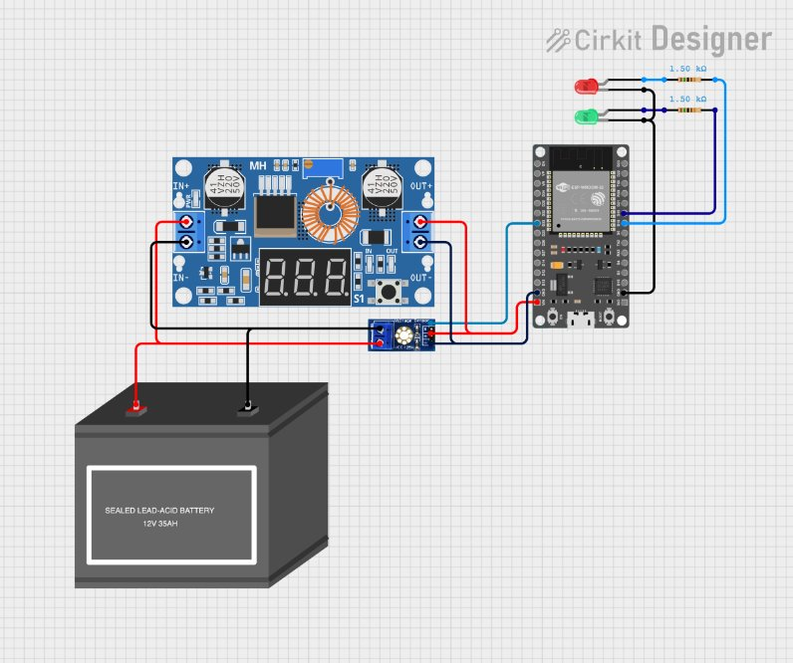
Methodology
The methodology involves designing a system that continuously monitors the battery voltage and provides real-time feedback to the user via the Blynk app and visual indicators.
Components:
ESP32 Microcontroller: Controls data acquisition and communication with Blynk app.
Buck Converter: Steps down voltage from the battery for ESP32 operation.
Voltage Divider: Utilizes resistors (e.g., R1 = 30kΩ, R2 = 7.5kΩ) to scale down battery voltage for accurate measurement.
LED Indicators: Provides visual feedback on battery status based on voltage thresholds.`
Circuit diagram:

Slide 6



Result
Voltage Readings: Continuous monitoring and reporting of battery voltage every second.
Alerts: Immediate notifications via Blynk app and serial monitor for voltage levels below 5V or above 7V.
LED Indicators: Real-time status updates (OK or Bad) based on monitored voltage thresholds.

Slide 7
Conclusion
Summary: Successful implementation of an IOT-based voltage drop detector for automotive batteries.
Achievements: Improved battery maintenance and failure prevention through real-time monitoring and alerts.
Future: Potential enhancements including integration with vehicle diagnostics systems and predictive maintenance algorithms.

Slide 8
Thank you

